Slide 1
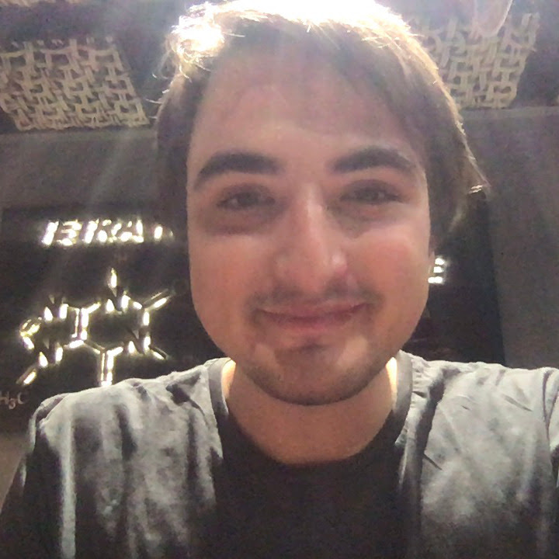




Requirement Analysis & Design ProMe by JMOSS
Ozan Marco Xuecong Farouk Sairaghav
Incesulu Fasanella Liu Jeffar Venkataraman

Slide 2
The Idea
Safety Application
Get safety score and details for a given location/street
Generate safest route from A to B
Report an incident
Notification for nearby incident when location is on

Slide 3
The Data Sources
Real-time Data:
User Reports
Near-time Data:
Area & incident news:
MilanoToday
Il Giorno
Corriere
Historic Data:
Official institutions (not live):
Istat
Polizia di Stato

Slide 4
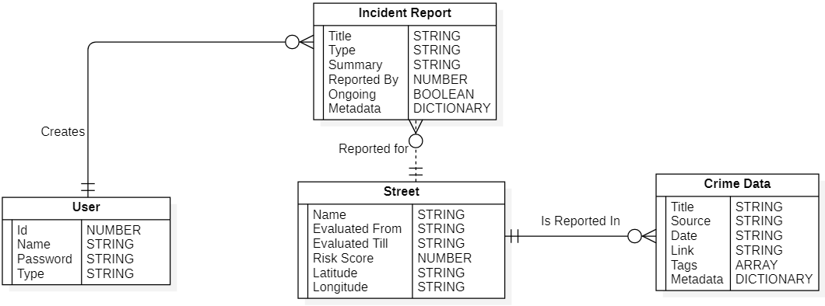
The Data

Slide 5
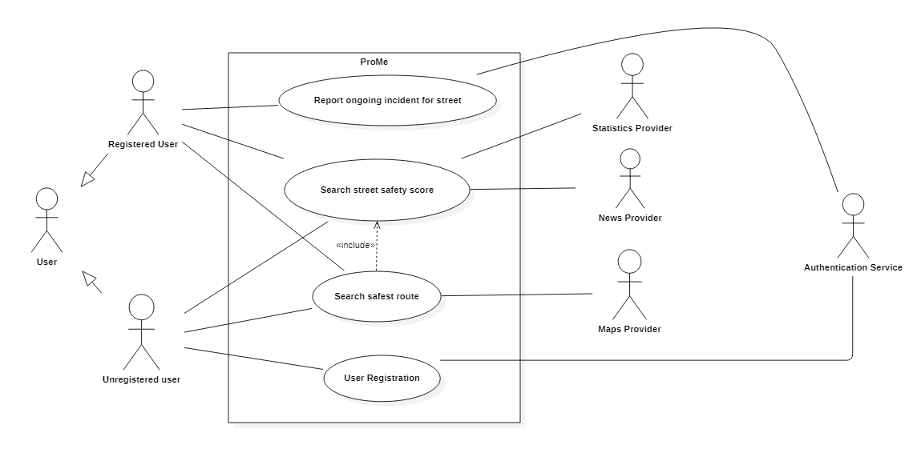
The Use-Cases

Slide 6
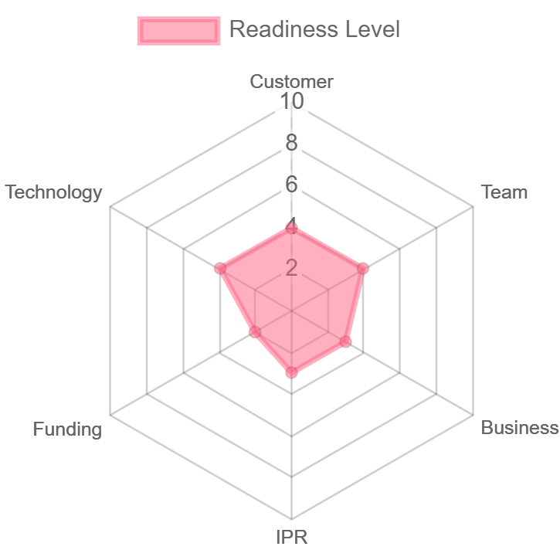
The Short-term Work plan - Setup and Validate
A working MVP for validation
Mobile app showing safety scores for given locations.
Confirmed needs from several customers.
A champion and several needed competencies. Plan for recruitment.
NABC.
Define funding needs.
Business model canvas.
Market potential and competition analysis.
Identify and describe possible key IPR.

Slide 7
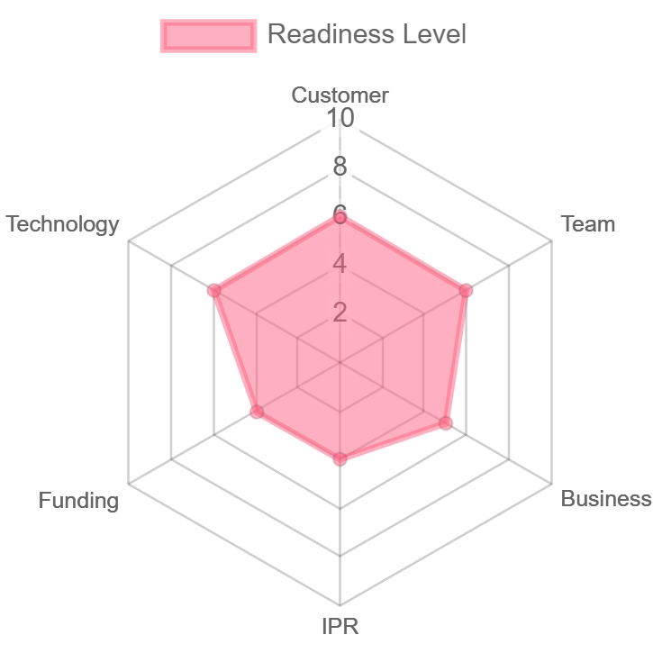
The Mid-range Work Plan - Fast Growth
A working prototype in small scale user testing.
Safe routing
Incident reporting
Web interface
Notifications
Benefits of the product confirmed through customer testing.
Complementary, diverse and committed team.
Good business pitch and presentation. Funding options.
Parts of the business model tested in the market. Verified competitive uniqueness.
Confirm patentability and decide IPR to protect.

Slide 8
The Proof of Concept - Where does it stand?
MVP - The Mobile App :
Street Safety
Incident report
Route Planning
Notifications
No:
Web application
Machine Learning

Slide 9
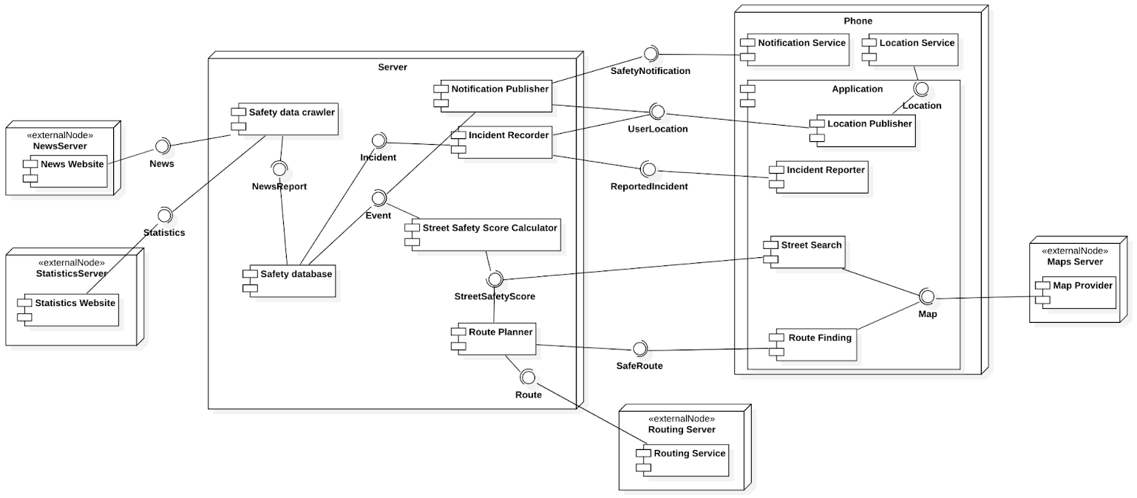
The Component Diagram

Slide 10
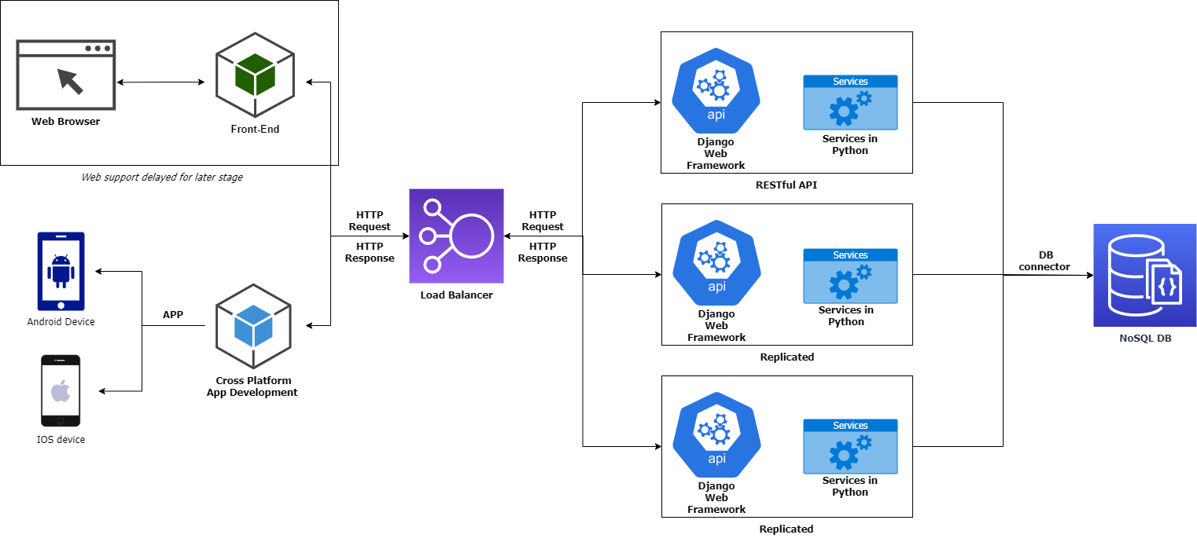
The High-Level Architecture & Technologies

Slide 11

The Risk Elements - What Could Go Wrong?
External API availability
Change in data structure of news providers
App used by criminals to exploit “safe” zones
Data Protection & malicious attacks
Zone discrimination
App used by trolls or criminals
!

Slide 12
How to Prevent the Risks?
Using reliable services
Use Premium APIs with support and contract
Bounty programs on white hat hacker platforms
Banning users with false reports
Crowdsourced confirmation of incidents

Slide 13
Thank You !

